Slide 1


Cash Training
City of London Aquatic Services

Slide 2
Welcome
If have additional questions:
Consult cash manual
Send a staff centre message to your supervisor
Ask your coworkers

Slide 3
Policies

Slide 4
Customer Service
Answering phones:
“Good morning, Byron Pool, Aaron speaking”
Always greet patrons as the enter your facility
Keep a clean front desk
This does not mean ignore patrons to clean, we ask that you clean your desk if it’s messy and you have the time to do so

Slide 5
Policies
We do not provide refunds
Consult with your supervisor
Issue a complimentary pass if needed
Thunderstorms/Pool Fouling etc.
Only within one hour of individual’s admission
We have rainy day passes, or compl passes
Only cash-trained staff behind the cash desk

Slide 6
Admission Policy
“Band” Customer
Orange
Ages 0 - 12
Green
Ages 13 - 17
Can be swim tested to get green band
Can get a STAC from the cashier
Pass?

Slide 7
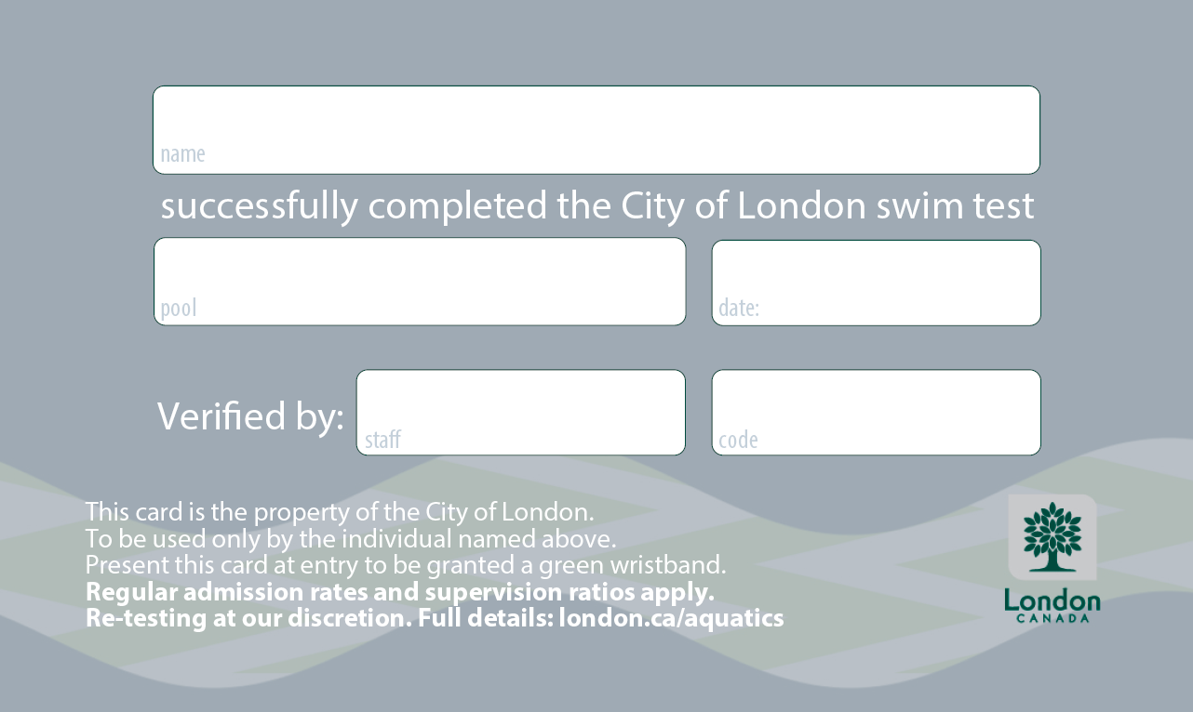
Swim Test Admission Card (STAC)
Can be given out by cashiers to individuals who have passed the swim test
They MUST have a green band securely attached to their wrist
The code section is filled out with 1) followed by favorite flavor of ice cream, or 2) followed by their favorite colour

Slide 8
Registration

Slide 9
Who?
R
Residents
London
Lambeth
N
Non-Residents
Komoka
Arva
Delaware
Notes:
In Spectrum pg 100-1

Slide 10
What?
Swim Passes
Lessons
Teams
Pool Leaders
Leadership
It is your responsibility to become knowledgeable about the programs offered by Aquatics.
Please consult with the Spectrum manual for more information.

Slide 11
Registration Process!
Customers must register:
Online
Distribute an information card
With a customer service clerk (in person or phone)

Slide 12
Reason for Changes with Registration
We changed the process to:
Be able to register 24/7 up until the day of course
Allow for greater control and consistency among pools
Allow for more options for payment (was previously only credit/cheque at pool)

Slide 13
General Lesson Policies
Do not offer make-up lessons due to vacations or illness
Generally require 50% enrollment or higher to run a class
Participants can transfer at any point of time,
Notes:
Show example of what registration sheets look like
When combining try to make it as close as possible; 1/2 , 3/4 not 1 and 4

Slide 14
Financial Assistance Program
We want everyone to have equal access to our programs regardless of social standing
Participants can apply for the city to pay for part/all of the price of the programs that we offer
Financial assistance requests must be made through one of the hub sites via a registration clerk

Slide 15
Financial Assistance Program
Based on the number of people in the household and the total household income
City will pay 100%, 50%, or 0%
If they qualify, they will receive $300 per person per year
Can use for any program or pass

Slide 16
Cash Handling Procedures

Slide 17
Your Responsibility…
Policies are in place in part for your benefit, safety and security
It is important that you follow them
Of course we take into consideration exceptional circumstances; however, we as the Management Team allow little or no flexibility in terms of dealing with a breach of cash handling procedures

Slide 18
Cash Handling Policy
Realize that a mistake has been made on your way home
call the Admin Coordinator or your ASUP
inform your Pool Manager
What’s worse?
Someone being tired from going out to secure money at 11pm
OR
Having to explain where your revenue went

Slide 19
Cash Handling Policy
ONLY cash-trained staff is allowed to be behind the front desk or handling registration/cash
If you need to be taken off your shift, please ensure that a cash trained person is watching the front desk
Leave your cash drawer OPEN at the end of your shift

Slide 20
Complimentary Passes
It is very important that all complimentary passes to the pool are tracked
Distributing Passes
Will be instructed by PM/APM to distribute
Accepting Passes
Accept pass
Press “Comp Pass” in POS, then CASH
Write “VOID” on front
Staple to drawer balance form at end of night

Slide 21
Stamps
Stamp hands for people who have paid, but would like to leave and return for the SAME swim
If a customer has paid for an afternoon rec swim, it DOES NOT entitle them to admission into evening rec swims

Slide 22
Splash Back
A customer who pays for admissions in the afternoon can come back in the evening for $2
Ask the customer if they would like their splash back ticket.
Give a stamped & filled out splash back coupon.
Valid only on the date of issue at the location indicated on the coupon/receipt for the same or fewer number of people.

Slide 23
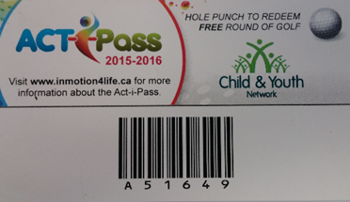
ACTI-Pass
Program for grade 5 students who have completed the registration process.
This is a research study with Western University, so accuracy is strongly encouraged.
We must make a pass for them, using the ACTI-Pass plan option.
Acquire a photo for their account, and issue them a key tag.

Slide 24
ACTI-Pass
Provides free admission to our recreational swims.
Valid for the person registered and a +1 complimentary admission for a guest.
The registered pass is entered through Pass Validation
The guest is entered through Point of Sale as a complimentary pass.
Standard admission policies still apply.

Slide 25
Camps

Slide 26
Hold Up Procedures
If you are ever confronted by anyone threatening you demanding money – hand it over immediately
Your safety is the paramount concern
Do not attempt to stall, resist or overpower the person in any way
As soon as it is safe, call 911. Inform the operator that you have been held up. Do not hang up the line until instructed.
Call a Manager immediately. You are given information in your Cashier Manual on things to note down immediately after the event. Make yourself familiar with these.

Slide 27
You have the Team you need in place to support you…
If you are unsure of anything, the answer is a simple phone call away.

Slide 28
Cashing Off
Print a Drawer Balance Report
Remove float from cash. Place remaining cash in a deposit envelope
Staple: Receipts, DBR & envelope flap
Place in balancing folder

Slide 29
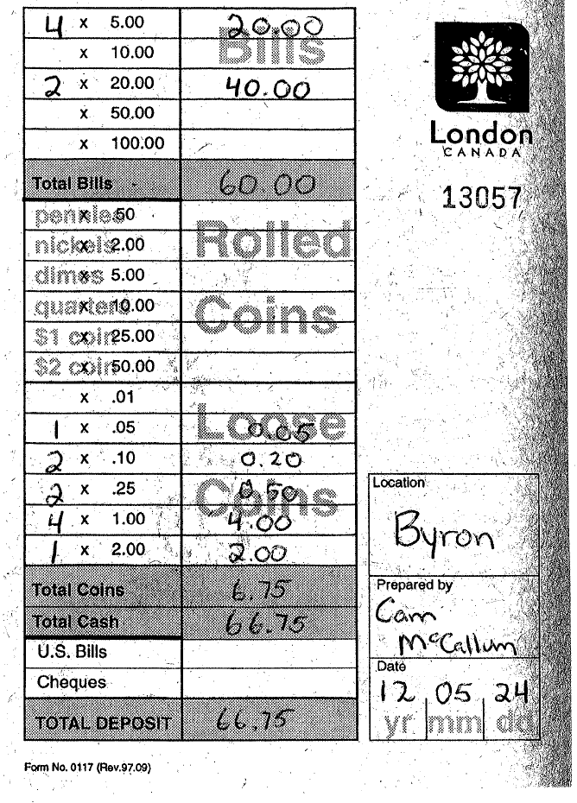
ROLLED COINS ONLY
PUT SHIFT (AFT/EVE)
FOR POS SALES (admissions, books, passes, etc.)
WRITE DATE ABOVE

Slide 30
Over/Short
YELLOW
Less than $5
Recount Float and Deposit
Write discrepancy on recap form
ORANGE
Less than $10, more than $5
YELLOW, plus:
Fill out an over/short report
RED
More than $10
Same as ORANGE, plus:
Call Admin Coordinator asap (leave a message if not answering)

Slide 31
CLASS DEMOS
If you want to practice class at any point use the following login:
Login: trainer
Password: Summer2017
Just make sure to log off of that account when you are done

Slide 32
Central Login

Slide 33
All the programs for cash are here. Some of these are more prevalent to our use than others.
At the end of each shift closing this window will ensure that you are logged out of CLASS.

Slide 34
Point of Sale
Please note there are differences between indoor and outdoor pools. These differences reflect the programs run at each pool and also their debit/ credit terminals.

Slide 35
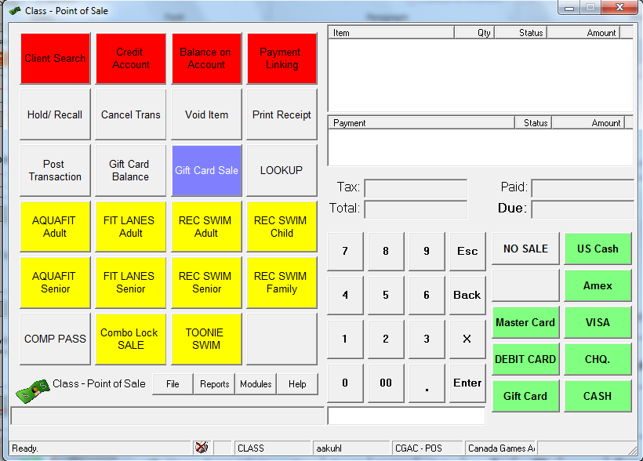
These are all of our payment options available
These are the most common payments you will be making throughout a cash shift.
Press the quantity desired, then select the admission type that you want
You can input multiple admissions quickly using the numbers below.

Slide 36
If clients needs to divide payment between multiple types of payment (part in cash, part in debit) there are a couple steps to follow
**IMPORTANT NOTE**
The cash register will only open after the total due is reduced to $0
Input the amount that they would like to pay using the number keys or buttons below, and select the payment method they need.
US Cash is taken at par (1:1)
Then process the remainder of the payment with the other method.

Slide 37
Debit/credit payments will vary based on your location as a number of different terminals exist.
Once you press okay the different terminals will behave differently.
Once you have the correct total for payment select the appropriate card type
They all share the same starting steps though.
This will open this window.

Slide 38
Our integrated terminals (all indoor pools, Glen Cairn, Oakridge, Stronach, Thames) will immediately show the total on the pin pad, and the client will complete the payment at that time.
Our separated terminals will not follow this pattern though.
Clicking okay will tell CLASS that the payment has been received.

Slide 39
These terminals require you to input the payment amount, and then the client will be able to process the payment.
One good method for using these terminals is to leave the window open until you receive confirmation that payment is approved.

Slide 40
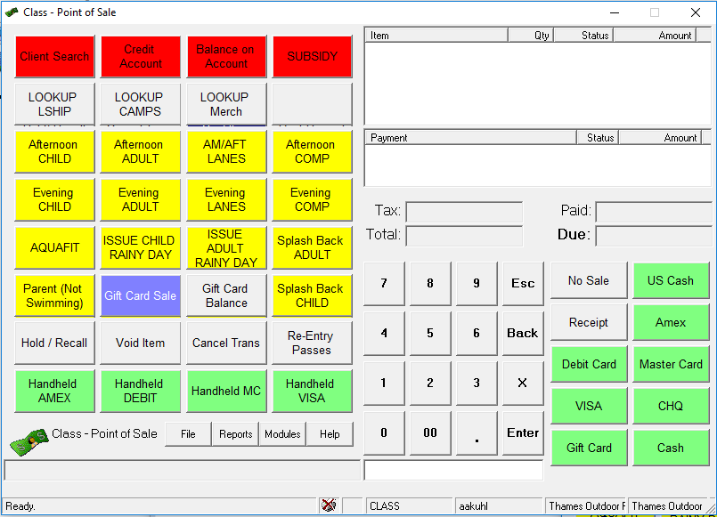
The cellular terminal is unique to Thames outdoor pool. This terminal is identical in nature to the separate systems, but is entered as handheld instead of the normal payment method.

Slide 41
At the end of your shift, if you use the separate or cellular terminal, you will need to settle the terminal. To do so you must follow these steps.
Once completed compare this to your drawer balance report. The two documents should show the correct balance. If they do not this is an outage that needs reporting follow the over/short guidelines.
Please attach the settlement report to your drawer balance report at the end of your shift.

Slide 42
Point of Sale
Voiding Transactions

Slide 43

Mistakes happen, so there are ways to fix errors in your transactions. They can occur at two times, prior to payment or after.
Prior to payment void item will remove the desired item without needing any additional steps.
However it is only usable before you receive payment.
And now we’re good!
Click on void item, and then click the item you want to void

Slide 44
The first step is clicking on hold/ recall
After you receive payment a Deck Supervisor, Pool Manager, or Assistant Pool Manager is needed to cancel a transaction.
When cancelling a transaction please only cancel transactions that are cash payments, issues can arise in cancelling credit cards, so please notify your Supervisor and have them handle this through finance
Next find the transaction in question, and click okay

Slide 45
Now press cancel transaction, and it will prompt you for the reason. Enter the reason and it is completed.

Slide 46
Point of Sale
Merchandise Lookup

Slide 47
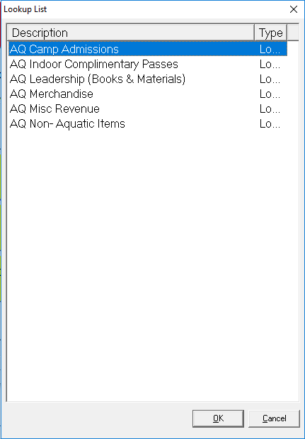
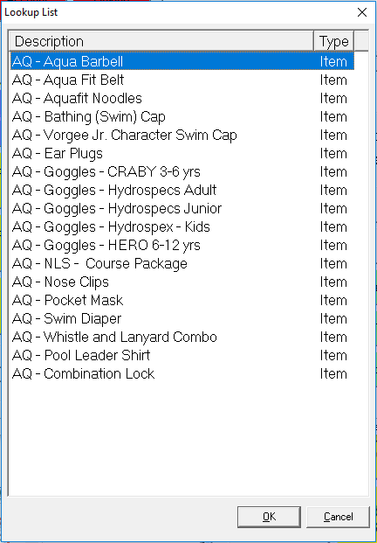
Every admission, payment or merchandise that is not found in the main screen is found under the look up option.
Leadership, and merchandise are the more common types.
Each facility will have their own supply

Slide 48
Point of Sale
Camp Admissions

Slide 49
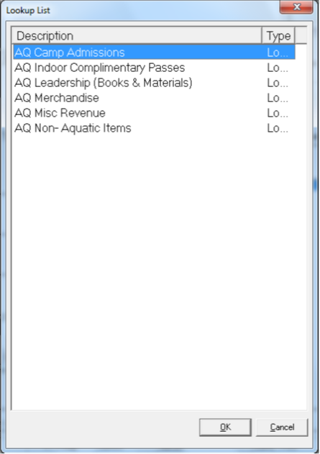
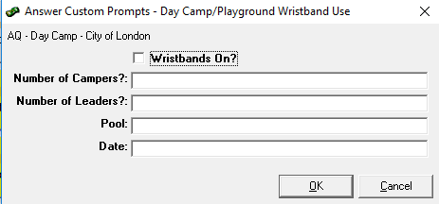
This is very important to complete. Ensure that cashiers are completing this prior to giving camps their wrist bands.
Camp admissions for City of London are also done through lookup
Once that’s done the following prompt will appear.
Fill in the information that the leaders provide
Select either Day camp or Playground, the camp will let you know

Slide 50
Point of Sale
Pay with Subsidy or Account Credit

Slide 51
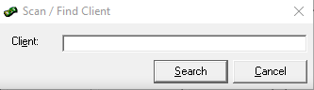
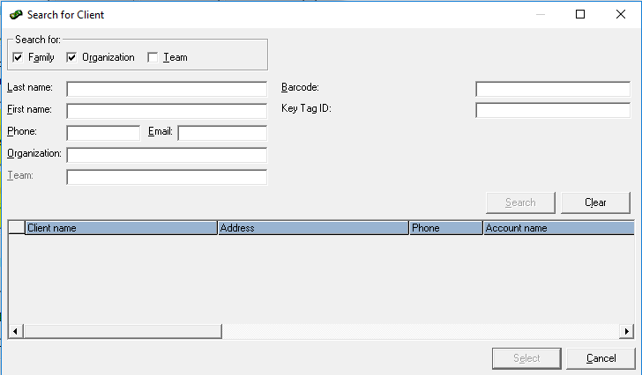
Note that with subsidy each person will be paying for their admission so it does take some time.
Then select the admission type, this will prompt you to apply subsidy, like this:
First search for the client who needs to pay.
Press CASH to finish the transaction and continue with your next transaction
Press search to bring up the full list of options.
This requires the above methods of identification.

Slide 52
Point of Sale
Add funds to an account

Slide 53
Follow the same steps as before to locate an account.

Slide 54
Point of Sale
Cashing Off
Pools will have different steps to cashing off, be sure to check with the manager on the shift to ensure that everything has been completed. This includes float verification, settling debit/ credit terminals (handheld or cellular only), camp admissions

Slide 55
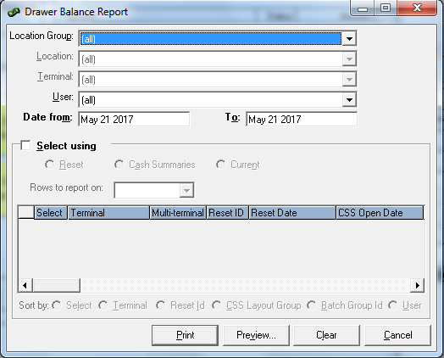

Slide 56
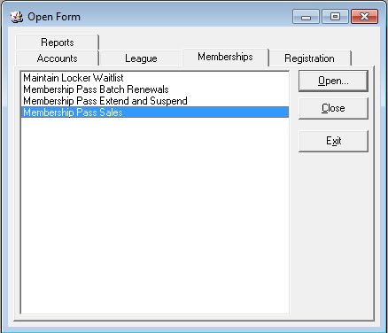
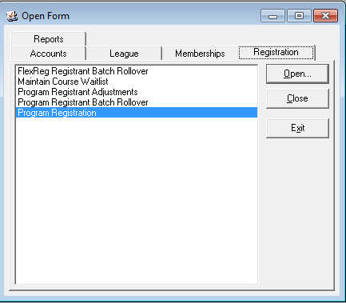
Program registration has two main functions
Sale of passes
Course registration
To note course registration is read only, and a useful tool for looking up course information.
We will start with looking at membership pass sales

Slide 57
Program Registration
Create/Find an Account

Slide 58
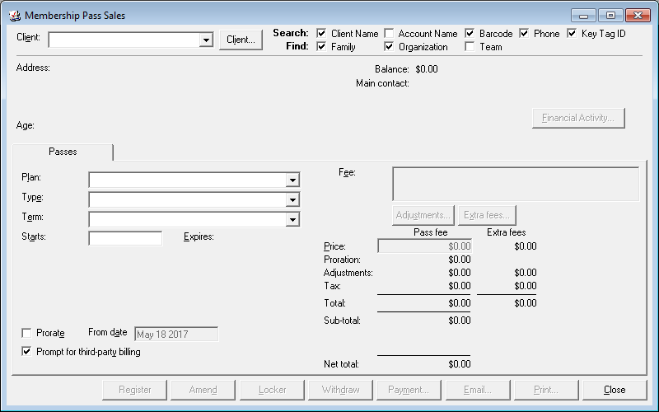
Some times phone numbers change, and they forget to notify us, so don’t hesitate to ask if they have changed their phone number recently if their account doesn’t show up.
This brings us back to this search screen
If you find a duplicate account, email your supervisor and they will be able to combine the accounts.
Try at least two methods for searching, as we like to avoid creating duplicate accounts.
The search bar can use any of the identifiers that you have checked off above to look for a client

Slide 59
If the correct name shows up you can access and edit the account, but if it does not you need to create a new account.

Slide 60
This is the family creation screen, there are a large number of fields that need to be entered accurately
Clicking on this text box will generate a new line, which allows you to add a new family member
When completed click on close, and save the new information
Email is the only optional field, but it is necessary to fill in if the family would like to use online registration

Slide 61
Program Registration
Maintain a Client

Slide 62
Clicking on account allows you access and alter all information for a family.
Client allows you to look up an individuals specific information, like passes and their key tag.
Using Maintain Family will take you to the family creation page, which was just covered and works the same way.
Remember to save all changes when you press close!

Slide 63
If they have a current key tag you can simply highlight the old tag number and scan in a new one!
Clicking this opens up a tab where you can change key tags in case of lost tags
Maintain details is where you can add a photo for pass holders. This will be covered on the next slide.
Course registration is not usable from this screen, but we’ll cover how you can use it later.
If not use the drop down menu to select Key Tag ID
We like having as few key tags assigned to each person as possible, but use your judgment! If a child comes swimming with two different guardians, having two key tags may be beneficial

Slide 64
Clicking on photograph will allow you to add a photo or update the one they currently have

Slide 65
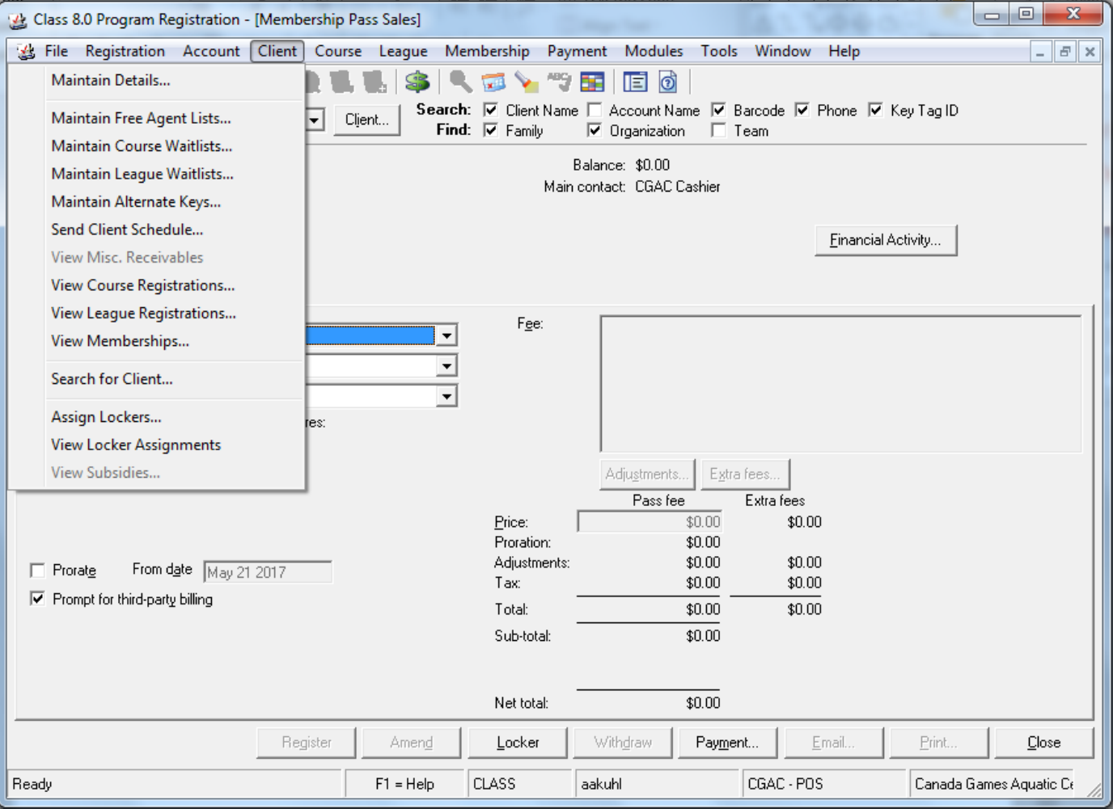
View memberships will show any active or past member ships in the window below
If you find a double scan let your supervisor know by sending an email with the pass name and key tag ID. They will add a swim back onto their pass
A normal pass will show how many swims remain without deducting from the pass, so it is the only way to check a balance for some one!
Additionally select a pass and hit view to see when and where the pass has been used. This is a great way to find double scans.

Slide 66
Program Registration
Sell a Pass

Slide 67
This option is to select the plan- CGAC/CHOCC/SLCP passes, outdoor pool passes, and ACTI Pass
When selling a pass make sure you have the right type (Adult, Senior, Child, Family)
Select the correct type of pass
The price should be correct, and if it is click register

Slide 68
To fix this, click on registration and ensure that registration mode is selected
The most common issue is when membership sales will not let you register for a pass. This is likely due to not being in registration mode.
If a patron would like to purchase multiple 10 or 20 visit passes at one time, you can use the drop down menu here to increase the amount

Slide 69
Program Registration
View Course Registration

Slide 70
Find the client, ensure that you have the correct name, and then select client from the top, and view course registration
As mentioned previously Program Registration is read-only, but will let you looking up any course registration.
This account doesn’t have any registrations, but normally you will see all current and past registrations here.

Slide 71
Program Registration
View Course Information

Slide 72
This search menu will need you to input as much or as little information as you want. The more you add (date, times, or location) will narrow down your search for courses.
Looking up courses can be done through here as well. Click on course to bring up the search menu.
Once you have found your course select it, and use the course tab above to view additional information, including course days and class lists.

Slide 73
Membership Pass Validation
Now that you can sell a pass it’s useful to know how to use one!

Slide 74
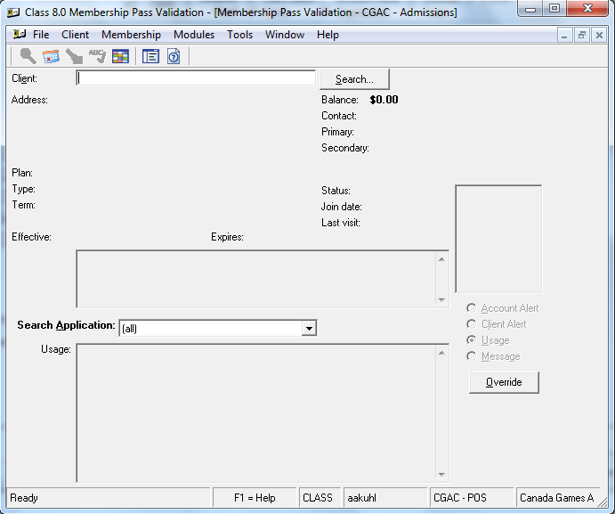
Just like with Membership pass sales, you can search without a key tag. Just use first and last name or a phone number!
If a pass is not scanning, ensure that you have selected (all) and that your cursor is clicked onto the client search bar.
If it’s still not working go to Membership pass sales and try to trouble shoot the issue. You may have to issue a new key tag!

Slide 75
Report Printing

Slide 78
Facility Booking

